Slide 1




Comprehensive AI Architecture to Monitor and Predict Heart Rate during Physical Exercises
Team
Talia Brooks
Aaron Bemis
Jack Morris
Alex Boyett
Lauren Schultz
Final deliverable Report
IT Capstone 4983
Kennesaw State University
November 20th, 2022

Slide 2
Contents
I. Introduction
II. Team
III. Contents
IV. Overall View
V. Milestone Assessment
VI. Project challenges
VII. Gantt chart
VIII. Project completion
VIIII. Final notes on the project

Slide 3
An introduction
The entire objective of this project was to develop data analytical models incorporated with cleaned and transformed Endomondo data to be able to predict heart rate during exercises based on this data.
We would accomplish this through several technologies mainly through a Jupyter Notebook server which we could analyze the Endomondo data and models. We used Python and Python libraries and several API's in gathering more data to transform the Endomondo data.

Slide 4
Overall View
Milestone 1: Take the provided raw exercise data and pull in weather and geographical data.
Milestone 2: Do simple processing on the collected data to prepare it for the models. Run different parameters through four different models and evaluate the results.
Milestone 3: Do more complex processing on the collected data and run in through more advanced models. Change the parameters for the new models to try and reduce the error rate as much as possible. We also ran two of the best models from Milestone 2 with the new processing method.
All Milestones: Complete weekly reports along with milestone reports and presentations for each milestone. Meet with our sponsor to ensure that our project is going smoothly. Communicate as a team to achieve our project goals and deadlines.

Slide 5
Milestone 1 objectives
I. Pull in Endomondo data (Raw) and combine it with geographical data and weather data.
II. Clean that data and prepare it for modeling.
(must have at least 1000)

Slide 6
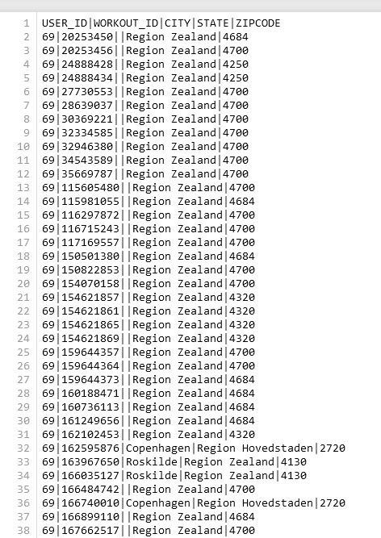
MILESTONE ONE
Geographical Data
For the collection of geographical data, we took the raw dataset, looked up city, state and zip code of the activity based on the provided latitude and longitude coordinates. The API called Nominatim for looking up this data has some limitations that ultimately led us to running parallel processes around the clock in order to obtain all the data we needed for this portion of the Milestone 1 requirement. Just like the raw data, we collected this into a single pipe delimited file for merging in our final step.

Slide 7
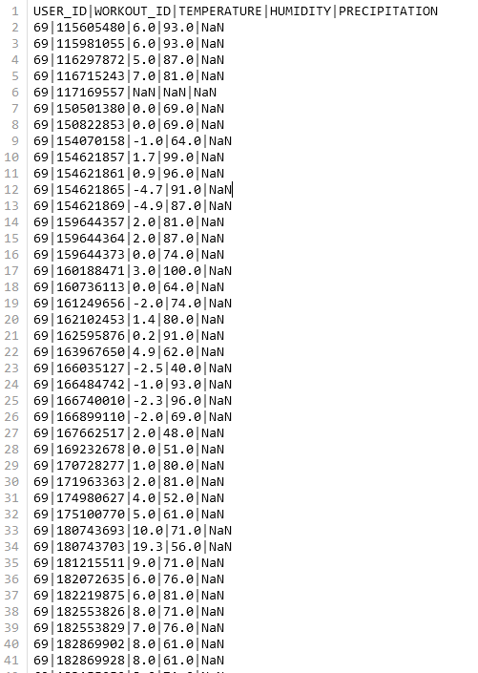
MILESTONE ONE
Weather Data
Weather data was obtained in a similar way as the geographical data. There were far less API restrictions for this data so acquiring it was much quicker. For this data, we would send the timestamp, latitude and longitude coordinates of the activity to the API meteostat and record the returned temperature, humidity and precipitation for that area for the hour of the timestamp. Once again, this was all captured in a single pipe delimited dataset for merging with the raw data.

Slide 8

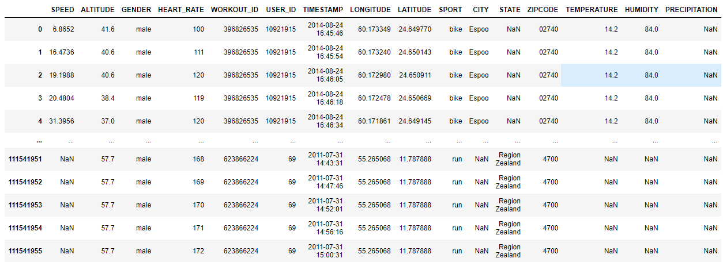
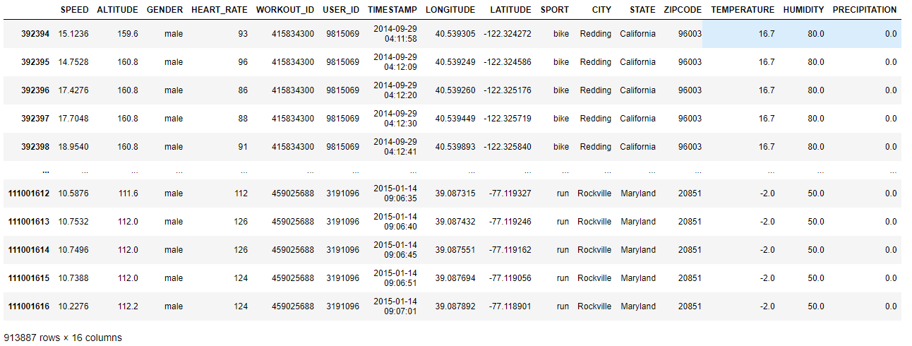
Milestone 1 Objective II Clean the data and prepare it for modeling.
Endomondo raw data, geographical data, and weather data combined in a table (and .csv).
Prepared through Jupyter Notebook using Pandas and Numpy.
Below: 1539 unique workouts with 500 data points no NaN, ready to be used.
8

Slide 9
Milestone 2 objectives
I. Process the model data to be able to predict the future heart rate of the user during their exercises from one data point to the next.
II. Figure out the parameters such as the size and number of blocks to run each of the model types (4 types of the same model for 4 models).
III. Use 4 different models. Each model has 4 sets of parameters that are adjusted for different runs. Each set of parameters runs 5 times to get an average heart rate prediction error rate.

Slide 10
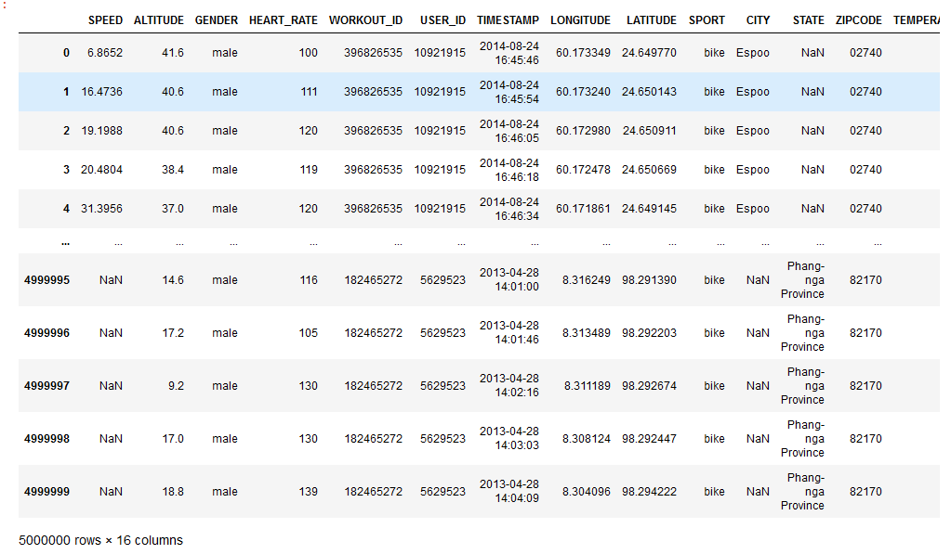
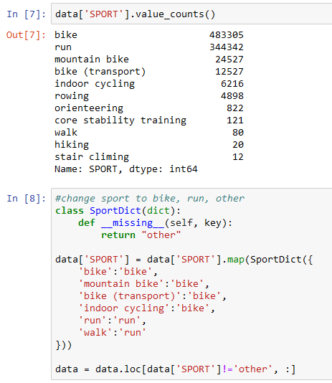
MILESTONE 2
We took 10,000 exercise that had 500 datapoints and turned that into an object for our models to use.
This gave us 5 million data entries the models could run against.
Timestamps were converted to seconds, broken into differences from one piece of data to the next and a running total was tracked as well.
Similar exercises were then combined into single exercises. This would help the model lump everything into two distinct categories biking or running.
The model could then take that input and learn about biking heartrates and running heartrates separate since they do differ greatly.
During processing gender was converted to binary. For our models, female became 0, male became 1 and some users did not report gender. Having gender helps the model during the learning process because the model would learn how different genders affect heart rates.

Slide 11
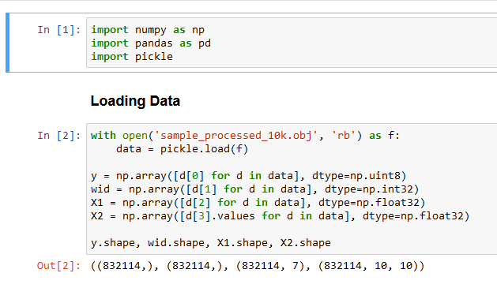
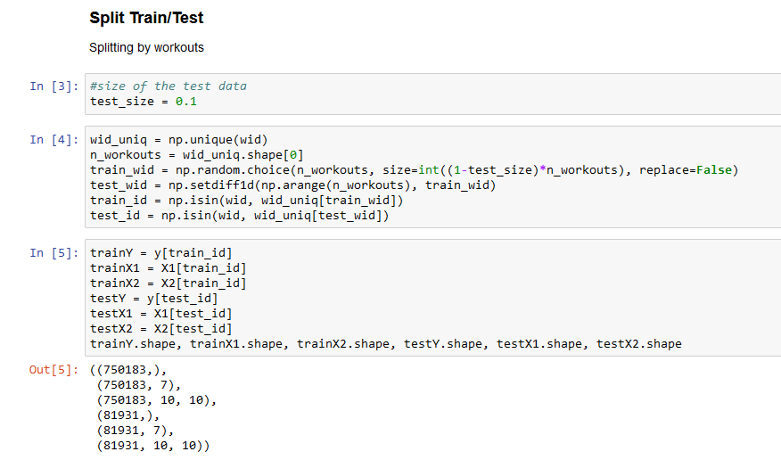
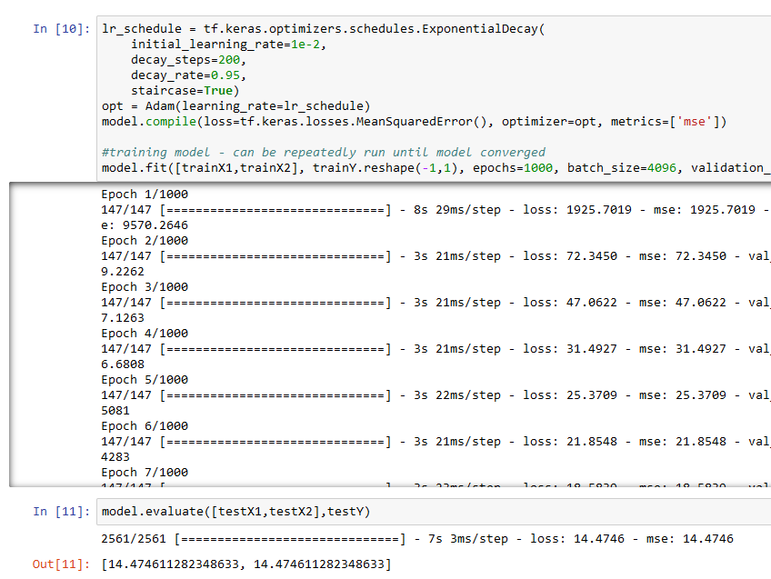
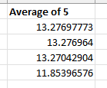

One-Dimensional Convolutional Neural Network
Input Parameters

Slide 12
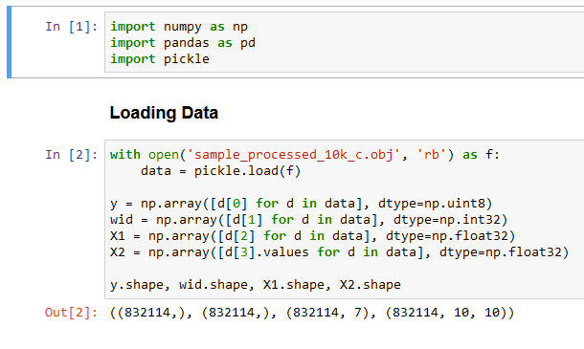
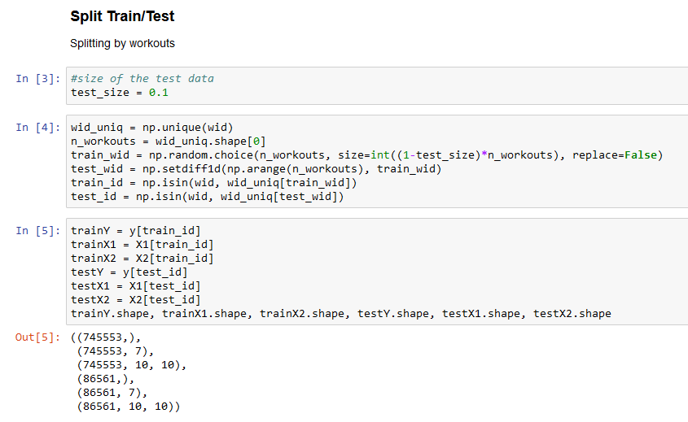
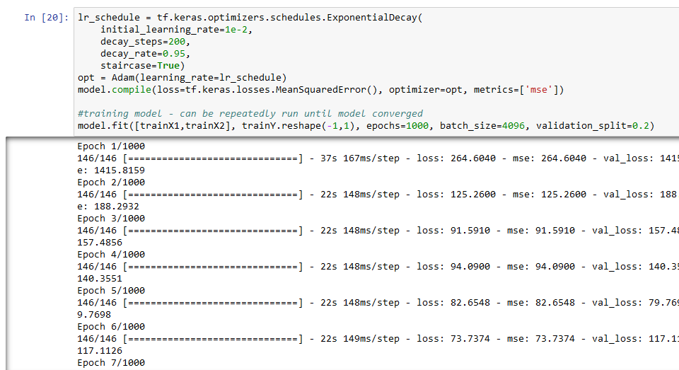

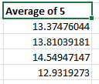
Long Short-Term Model
Input Parameters

Slide 13
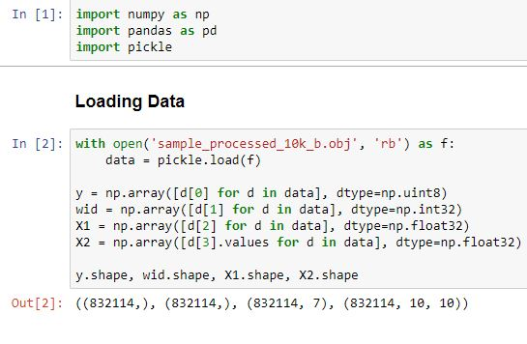
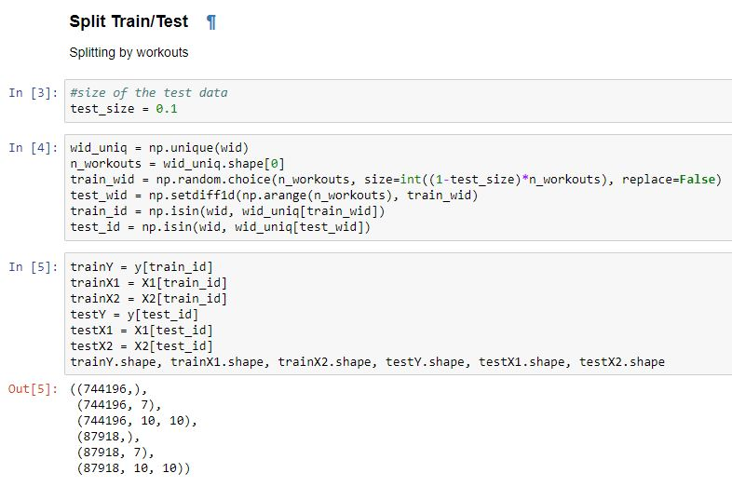
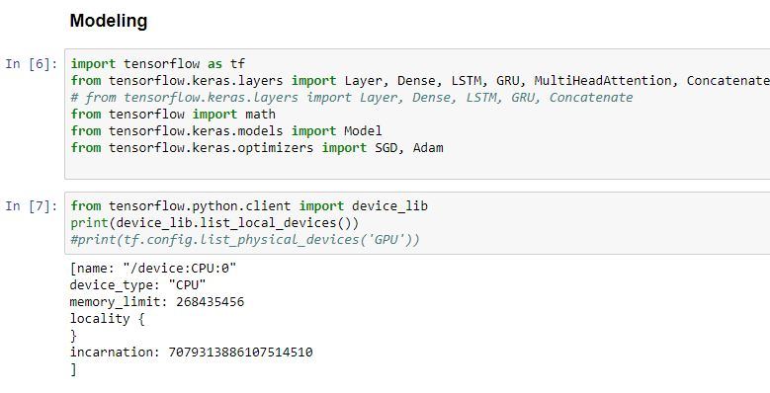
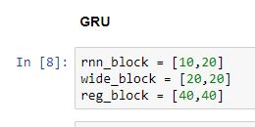
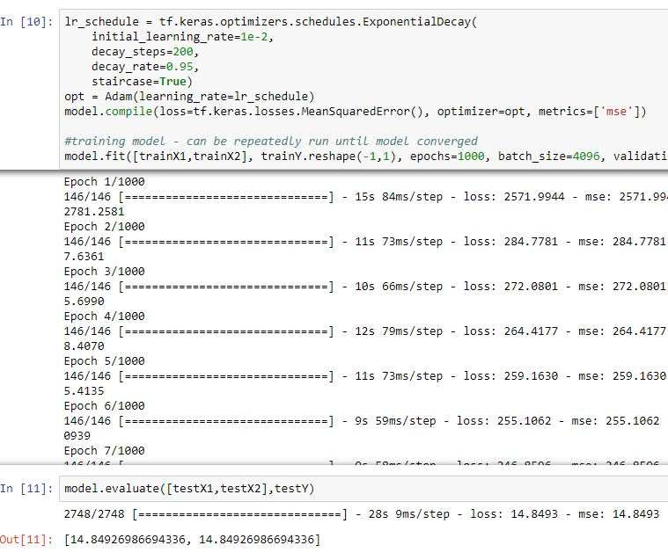
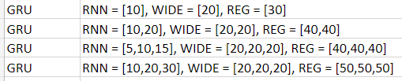
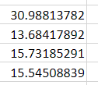
Gated Recurrent Unit
Model type with parameters
Average error
13

Slide 14
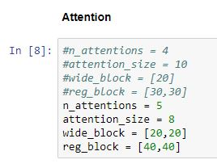
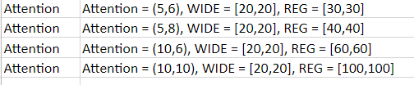
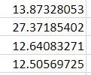
Multi-head Attention
Model type with parameters
Average error

Slide 15
Milestone 3 objectives
To complete the final deliverables for our project sponsor.
New way of processing the raw data to add in more elements.
Take the new model created by our sponsor and change the input parameters to try and make the error rate as low as possible.
Compare GRU and CNN basic models performance to the new Model.
Speak with our sponsor and confirm final deliverables

Slide 16
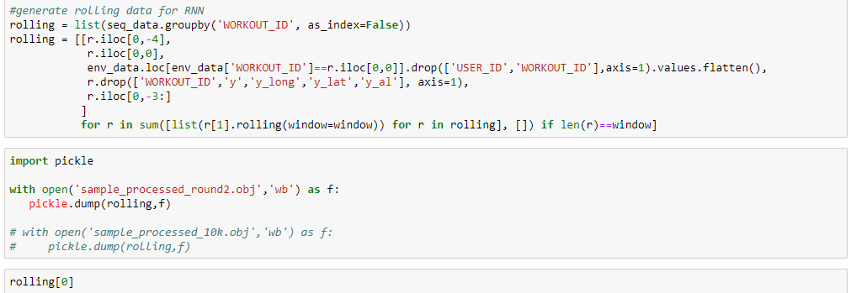
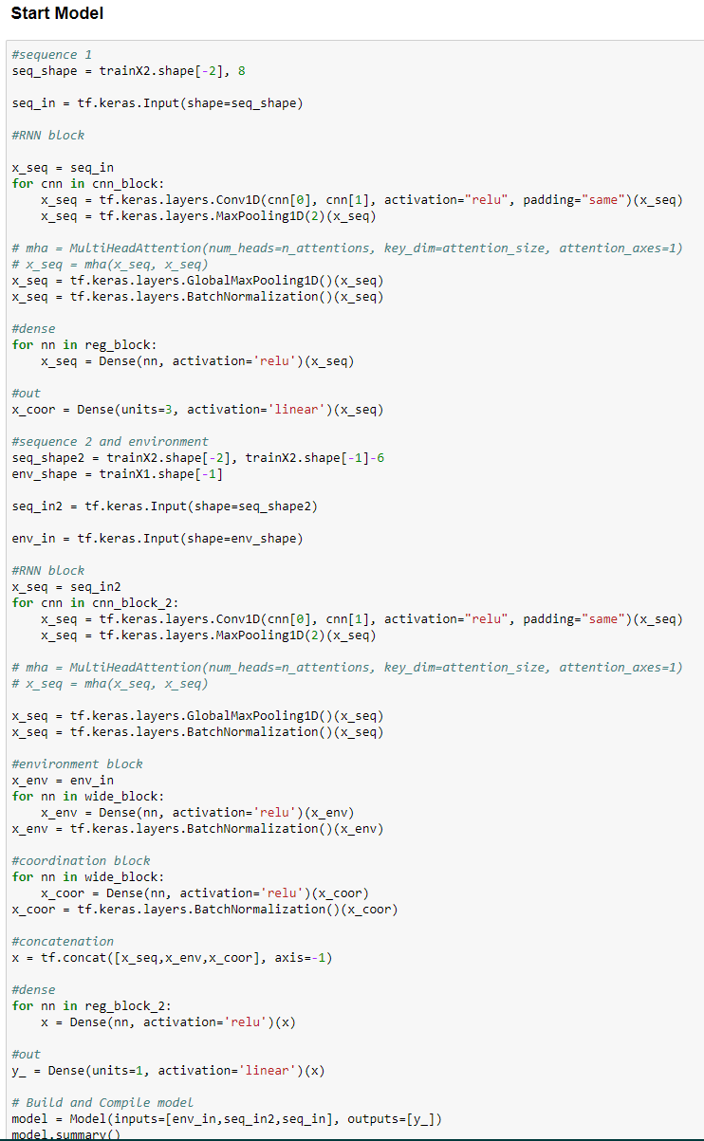
MILESTONE 3
Processing file for Milestone 3 model
Milestone 3 Modeling file
Uses the same data file as Milestone 2 of 5 million datapoints.
Sponsor worked closely with us in the construction of Milestone 2 and Milestone 3 models.

Slide 17
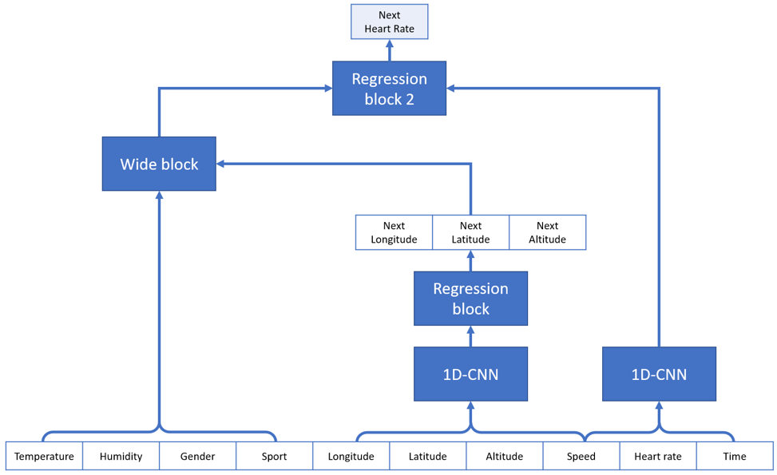
Milestone 3 Model
Milestone 3 Model is a more complicated model than the previous Milestone 2 basic models.
There are two 1D-CNN layers, with a wide block for environment data, and multiple regression blocks that we need to decide on the number of layers and size of layer just as wide block.
Several combinations is satisfactory.
In this case, 5 runs of 4 types of combinations is satisfactory.
We decide on the parameters for the new model.
Milestone 3 Model

Slide 18
Milestone 3 Model Run Results
The bottom 4 models are the results of the new Milestone 3 model that was developed.
The two other models (Top: 1D-CNN Middle: GRU) at the top are Milestone 2 basic models that are the best performing of Milestone 2 and of their type that we are comparing to.
The averages of the new Model are close to the best average of Milestone 2 CNN runs with the 2nd type of the New Model having a lower average than the Milestone 2 CNN.
Continued: As a result of these runs we have demonstrated that under certain filters and size of filters and other environmental and regression blocks that we are able to more accurately predict heart rates, as this new model predicts heart rates more accurately from the true heart rate with a difference improvement of 0.42657871 from the best selected models from Milestone 2.

Slide 19
Complete Project Challenges
Original plan
Deviation
Talk to the sponsor about the final steps in the project
Send in submissions for C day
Edit parameters and run models again
Record presentations
Even with edited parameters the error rate was very high. The error in the model was corrected by our sponsor and everything worked great afterward.
C-Day registration was a bit more involved than we had anticipated. Mostly figuring out what was required for those of us that are online only.

Slide 20
Challenges continued...
Pros
Cons
Challenges
Independently working means certain members can focus on certain areas
This was more model adjustment rather than starting from scratch which made it easier
End of the semester means many more projects which makes time much more limited for some members
Limited memory on the server meant less models could be running concurrently
Hard to tell what member needed to do what sometimes as options were limited
Deciding on times and being available to record the presentations

Slide 21
Final Notes of the project
What was learned
What could be improved
Goals for next project
Team jobs and positions, someone who started as team leader ended up being more suited for a recording role instead as an example
Assigning each team member a role and not just letting it be a free for all on who does what
Project Management – this class has been a great introduction to working on long term projects in a group setting
Have access to more servers and or better/more optimized server performance.
Streamlined project management.
How to use a shared server data processing and programing
How to coordinate as a fully online team
How to communicate effectively with a sponsor or higher up
How to run given data to prepare it for models
More familiar with Python, Python libraries such as Pandas, Jupyter Notebook, connecting to servers, working with API's.

Slide 22
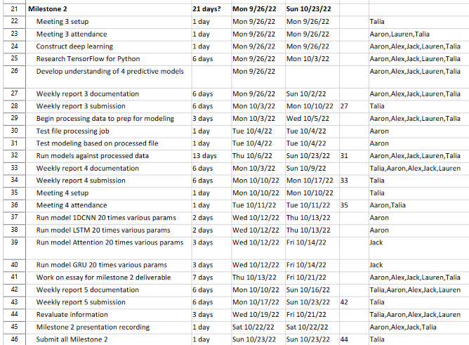
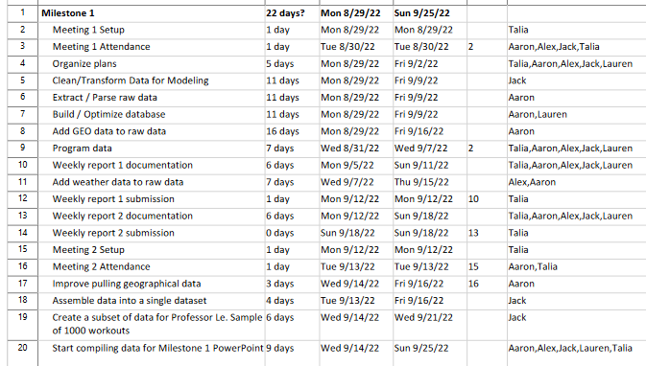
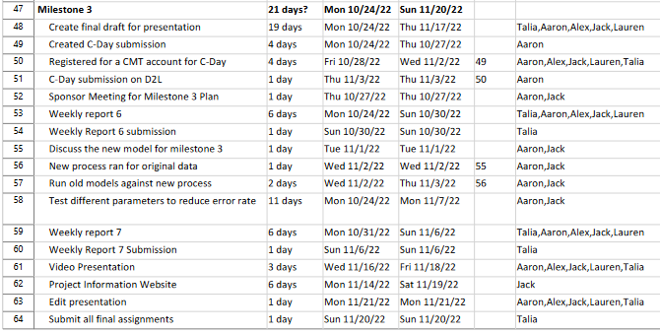
Gantt charts

Slide 23
References
Jianmo Ni, Larry Muhlstein, Julian McAuley, "Modeling heart rate and activity data for personalized fitness recommendation", in Proc. of the 2019 World Wide Web Conference (WWW'19), San Francisco, US, May. 2019.
FitRec-project. FitRec-Project. (n.d.). Retrieved September 22, 2022, from https://sites.google.com/eng.ucsd.edu/fitrec-project/home‌
“Nominatim.” Nominatim.org, nominatim.org/.
“The Weather’s Record Keeper.” Meteostat, meteostat.net/en/.
Pandas. “Python Data Analysis Library — Pandas: Python Data Analysis Library.” Pydata.org, 2018, pandas.pydata.org/.
Jupyter Project Documentation#. Jupyter Project Documentation - Jupyter Documentation 4.1.1 alpha documentation. (n.d.). Retrieved September 22, 2022, from https://docs.jupyter.org/en/latest/
By: IBM Cloud Education. (n.d.). What is supervised learning? IBM. Retrieved October 21, 2022, from https://www.ibm.com/cloud/learn/supervised-learning
Brownlee, Jason. “1D Convolutional Neural Network Models for Human Activity Recognition.” Machine Learning Mastery, 20 Sept. 2018, machinelearningmastery.com/cnn-models-for-human-activity-recognition-time-series-classification/.
Brownlee, Jason. “A Gentle Introduction to Long Short-Term Memory Networks by the Experts.” Machine Learning Mastery, 19 July 2017, machinelearningmastery.com/gentle-introduction-long-short-term-memory-networks-experts/.
Papers with code - multi-head attention explained. Explained | Papers With Code. (n.d.). Retrieved October 23, 2022, from https://paperswithcode.com/method/multi-head-attention
Kostadinov, S. (2019, November 10). Understanding GRU networks. Medium. Retrieved October 23, 2022, from https://towardsdatascience.com/understanding-gru-networks-2ef37df6c9be
Le, L. (2022, September 27). Modeling Instructions. Linh Le.

